Slide 1
Business Challenge:
Ironhack Payments
Project 1 Collaborators:
Ginosca Alejandro
Natanael Santiago
Paola Rivera
Dan Bigman

Slide 2
Key insights
Exploratory Data Analysis:
Table numbers of rows, columns, and data types
Number of missing values per column
Data Processing:
Replace unknown dates with ‘NaT’
Change date strings to pandas date format
Add column and assign cohorts
Data Cleaning:
Dropped rows without id, add missing categories

Slide 3
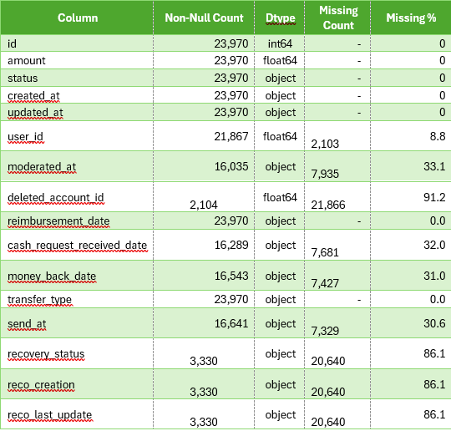
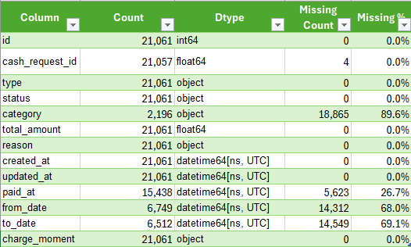
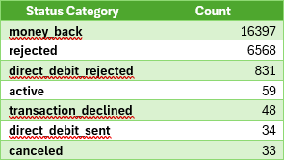
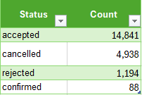
Exploratory Data Analysis: Cash Requests and Fees Datasets
This examines the structure, completeness, and key distributions in the 'cash requests' and 'fees' datasets to prepare for downstream analysis.
No duplicate rows in either dataset.
1141 deleted unique users
extract - cash request - data analyst.csv
extract - fees - data analyst - .csv
Notes:
Ginosca

Slide 4
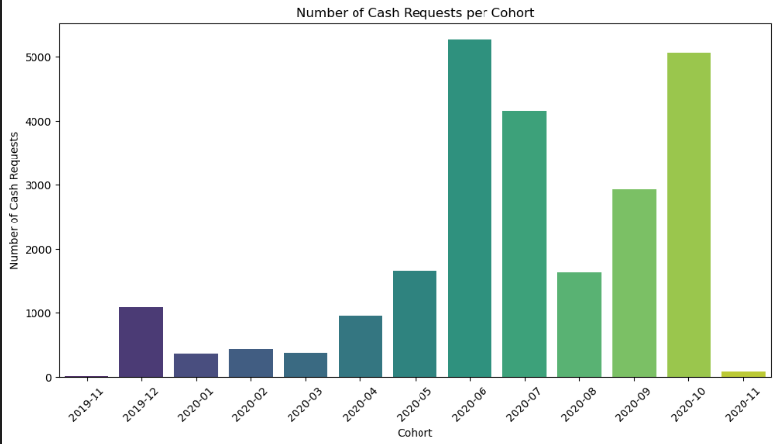
Frequency of Service Usage
Notes:
Natanael

Slide 5
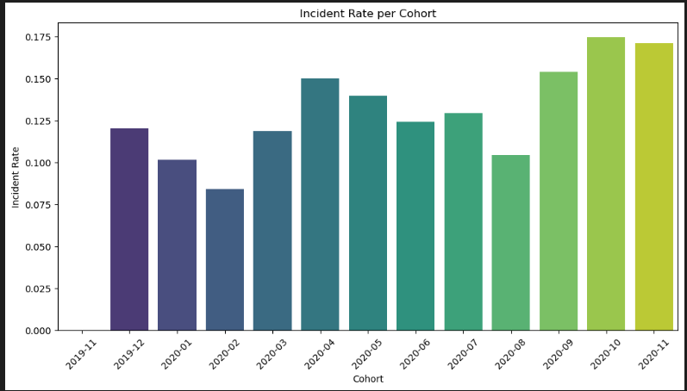
Incident Rate
Notes:
Natanael

Slide 6
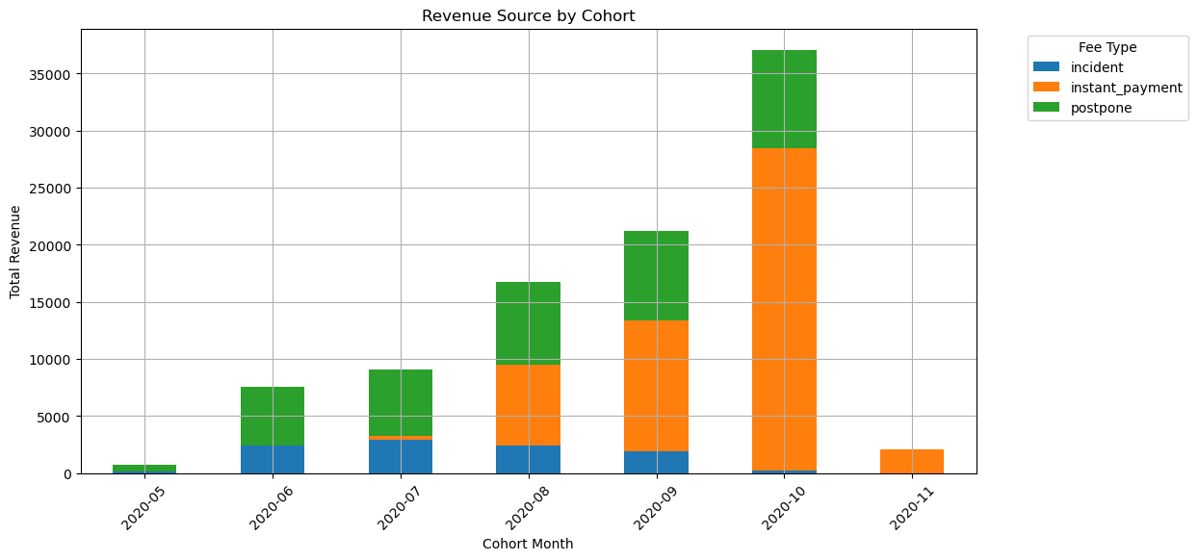
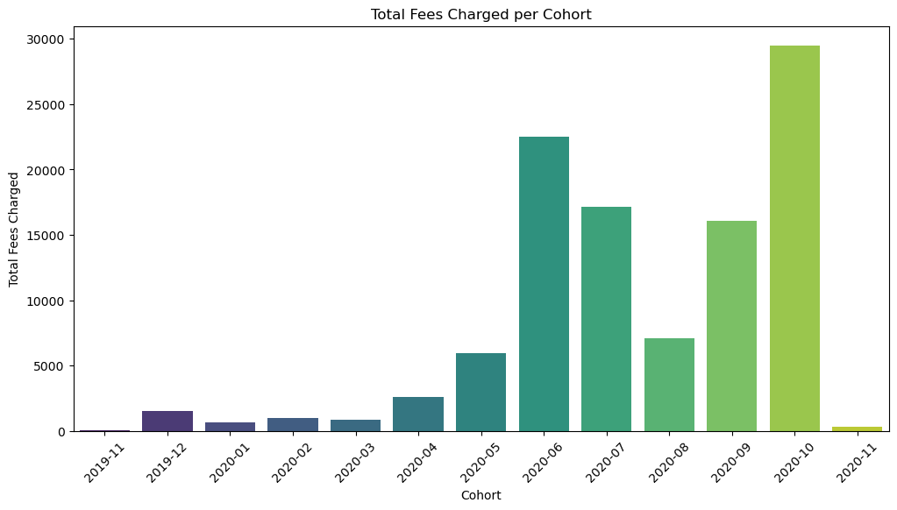
Revenue Generated by Cohort
Notes:
Ginosca

Slide 7
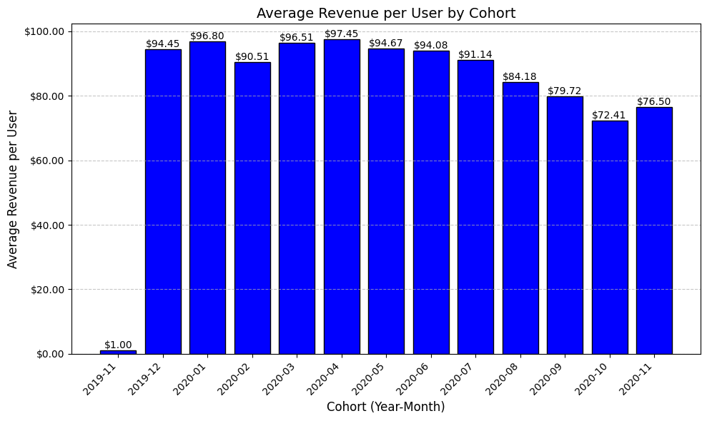
New Relevant Metric: Revenue per User by Cohort
# Group by cohort and count the number of requests
cohort_counts = df.groupby('cohort').size().reset_index(name='cash_request_count')
Notes:
Dan

Slide 8
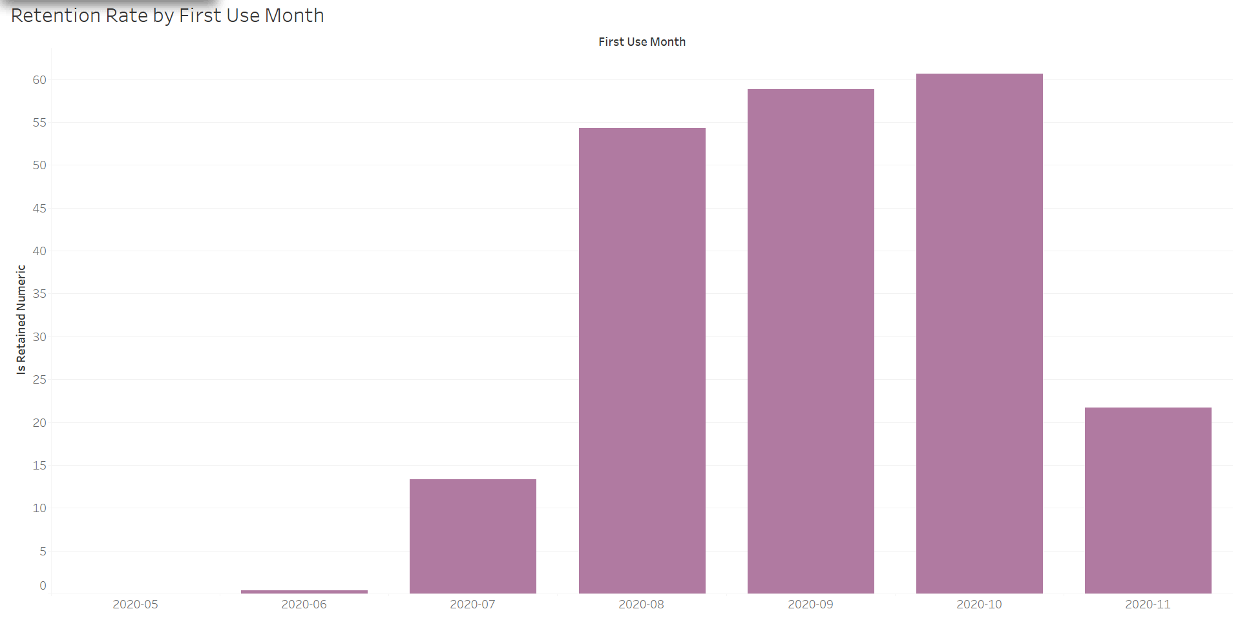
New Relevant Metric: Retention Rate
Main Takeaways:
Tracks how many users from each cohort continue making payments
Retention Rate = # of users who made 2nd payment / total # of users in a cohort
Users who used the service in 2020-10 for the first time were the most retained users
Notes:
Paola

Slide 9
Recommendations:
As a data analyst, after performing the cohort analysis, retention rate analysis, and examining the revenue generated from cohorts, we can provide the company with several key recommendations to optimize business performance. Based on our findings, here are some possible recommendations:
Improve User Retention Strategies
Recommendation: If you observe significant drop-offs in retention over time (e.g., after the first month or after certain cohorts), you could recommend that the company invest in improving user engagement and retention strategies.
Targeted Marketing for High-Value Cohorts
Recommendation: Based on cohort revenue analysis, if certain cohorts generate more revenue over time, the company can increase marketing efforts targeting similar cohorts.
Address Payment Issues (Incidents)
Recommendation: If a significant number of users experience payment issues (failed or pending transactions), it’s crucial to address the payment process to reduce churn and improve revenue.

Slide 10
Actionable Steps:
Improve User Retention Strategies:
Implement targeted email campaigns, in-app messaging, or personalized offers to keep users engaged.
Identify specific touchpoints where users tend to drop off and optimize the user experience around these points (e.g., onboarding process, first payment).
Consider loyalty programs, discounts, or exclusive content for long-term users.
Targeted Marketing for High-Value Cohorts
Leverage user acquisition strategies focusing on characteristics of high-value cohorts (e.g., high-paying customers, frequent users).
Expand marketing budgets for channels that perform well with higher-value cohorts.
Use advanced segmentation and personalization to create tailored campaigns for these high-performing groups.
Address Payment Issues (Incidents)
Investigate the root causes of payment incidents and streamline the payment process to reduce friction.
Work with payment processors to ensure smoother transactions, such as better handling of failed payments and offering users alternative payment methods.
Provide better communication and support to users facing payment issues, offering assistance to resolve payment problems quickly.

Slide 11

THANK YOU!
Notes:
Paola

